Slide 1
Digital Portfolio
STUDENT NAME: ARUN.S
REGISTER NO AND NMID: 24132161802521014
DEPARTMENT: B.SC., COMPUTER SCIENCE
COLLEGE: GOVERNMENT ARTS AND SCIENCE COLLEGE THIRUVENNAINALLUR/ANNAMALAI

Slide 2
PROJECT TITLE
DRINK WATER

Slide 3


AGENDA
Problem Statement
Project Overview
End Users
Tools and Technologies
Portfolio design and Layout
Features and Functionality
Results and Screenshots
Conclusion
Github Link
3/21/2024 Annual Review

Slide 4

PROBLEM STATEMENT
Many people, especially students and office workers, do not drink enough water daily, leading to dehydration, fatigue, poor concentration, and long-term health issues. There is a need for a system or solution that encourages and reminds individuals to drink adequate water throughout the day to maintain proper hydration and promote overall health.

Slide 5
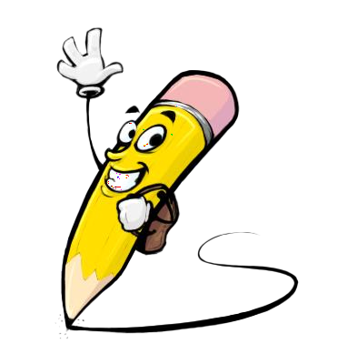
PROJECT OVERVIEW
The “Drink Water” project aims to promote healthy hydration habits by reminding users to drink water regularly throughout the day. The system can track daily water intake, send timely alerts or notifications, and provide visual progress to motivate users to reach their hydration goals. By encouraging consistent water consumption, the project helps improve overall health, energy levels, and concentration.

Slide 6

WHO ARE THE END USERS?
The end users of the “Drink Water” project are students, office workers, fitness enthusiasts, elderly people, and anyone who wants to maintain proper hydration and improve their overall health.

Slide 7

TOOLS AND TECHNIQUES
Mobile App / Software Platforms – for reminders and tracking (e.g., Android Studio, Xcode, or web-based tools). Notification Systems – push notifications or alarms to remind users to drink water. Spreadsheets / Databases – to log daily water intake. Sensors / Smart Bottles (optional) – to automatically measure water consumption. Techniques: Reminders & Alerts – periodic notifications to encourage drinking water. Progress Tracking – charts or visuals showing daily intake vs. target. Goal Setting – allowing users to set personalized hydration goals. User Engagement – gamification or rewards to motivate consistent hydration.

Slide 8
POTFOLIO DESIGN AND LAYOUT
. Cover Page Project Title: “Drink Water: Stay Healthy, Stay Hydrated” Your Name / Team Name Class / Grade / School Date Optional: Relevant graphic (water droplet, glass of water, etc.) 2. Introduction / Overview Brief description of the project Purpose and importance of drinking water 3. Problem Statement Describe the problem of dehydration and low water intake 4. Objectives List the main goals of the project (e.g., remind users to drink water, track daily intake) 5. End Users Define who will benefit from the project
8

Slide 9
FEATURES AND FUNCTIONALITY
Features: 1. Daily Water Intake Tracking – Allows users to log how much water they drink each day. 2. Reminders & Notifications – Sends alerts to remind users to drink water at regular intervals. 3. Goal Setting – Users can set daily hydration targets based on their needs. 4. Progress Visualization – Displays charts, graphs, or percentage completion of daily goals. 5. User-Friendly Interface – Simple and easy-to-use design for all age groups. Functionality: Interactive Logging – Users can quickly add water intake with a click or tap. Real-Time Updates – Progress updates as users log water. Motivation Features – Gamification, badges, or reminders to encourage consistent hydration. Adaptability – Works on different devices (mobile, tablet, or web).

Slide 10

RESULTS AND SCREENSHOTS
Results: Users are reminded to drink water regularly throughout the day. Daily water intake is tracked accurately, helping users meet their hydration goals. Progress visualization motivates users to maintain healthy hydration habits. Improved awareness about the importance of drinking water. --- Screenshot / Visual Example: You can include a mockup or screenshot like this: [Screenshot Example Description] Home Screen / Dashboard: Shows daily water goal (e.g., 8 glasses) and current intake. Add Water Button: Users can tap to log each glass of water. Progress Chart / Bar: Visual representation of water intake vs. goal. Reminder Notification Pop-up: Example of alert reminding users to drink waer.
3/21/2024 Annual Review
10

Slide 11
CONCLUSION
The “Drink Water” project successfully promotes healthy hydration habits by reminding users to drink water regularly and helping them track their daily intake. By providing notifications, progress tracking, and goal-setting features, the project encourages consistent water consumption, improves overall health, energy levels, and concentration. This simple yet effective solution raises awareness about the importance of staying hydrated and supports users in adopting a healthier lifetyles.
11

